Slide 1


DL Asg 1
Dominic

Slide 2
Approach (Model from scratch)
Start out with a base model
Tuning the different hyperparameters
Taking the optimal value from different values
Do this until all hyperparameters are tuned
Rationale
Most systematic way of tuning a model
Complex relationship between hyperparameters

Slide 3
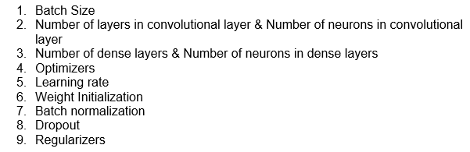
Hyperparameters

Slide 4
Approach (Pre-Train)
Start out with a base model
Fine tune the model
Prevent overfitting
Find best architecture for classifier

Slide 5
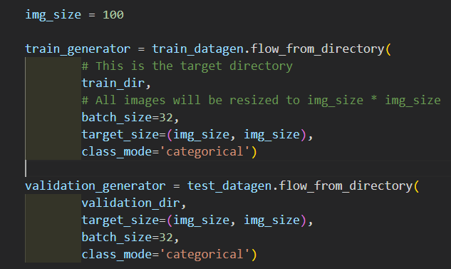
Data Augmentation
Helps increase number of data model trains with
Slightly modifies original images to create new ones

Slide 6
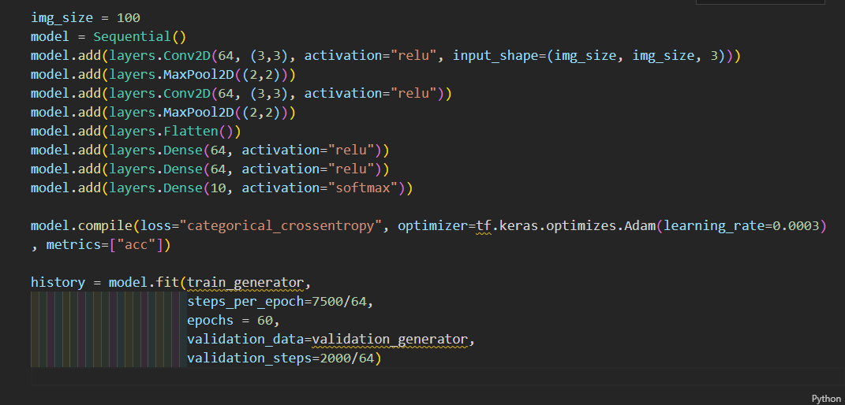
Base Model

Slide 7
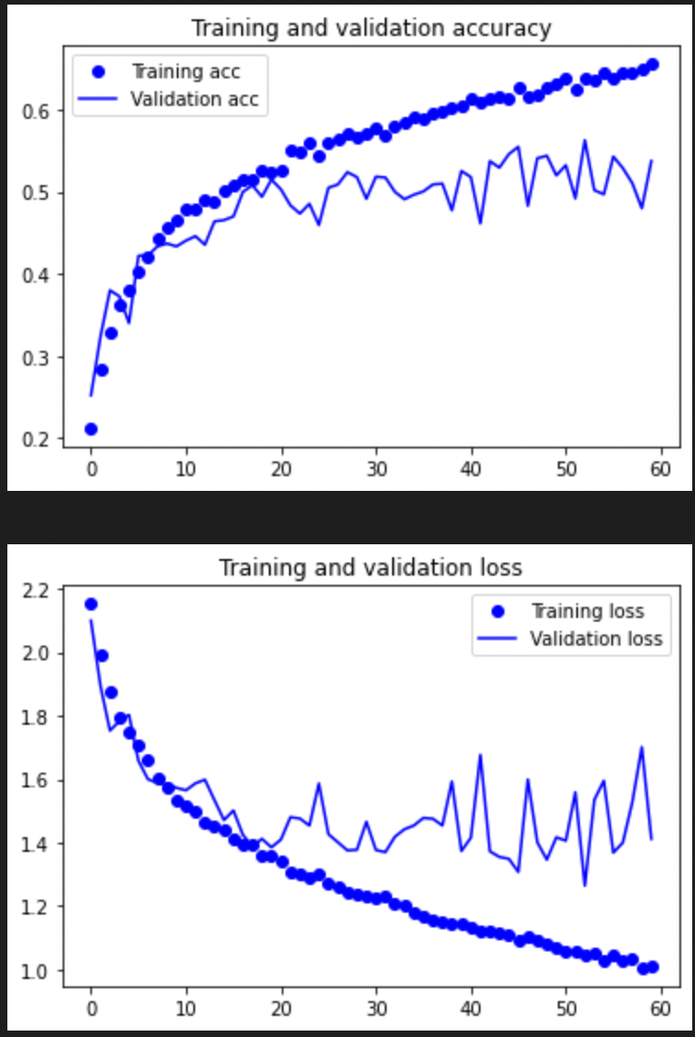
Base Model
Validation acc before overfitting ~ 52%
Overfits at ~ Epoch 45

Slide 8
Batch Size
No. of training data model trains with before “learning”
Looking for a batch size that takes accurate steps towards the global minimum
Yet small enough to escape any local minimums
Testing with batch size of 32, 64(base), 128, 256
Notes:
Smaller BS converge faster and more noise (can escape local minimums)
Large better gradient estimate (susceptible to falling into local min as gradient is often not convex)

Slide 9
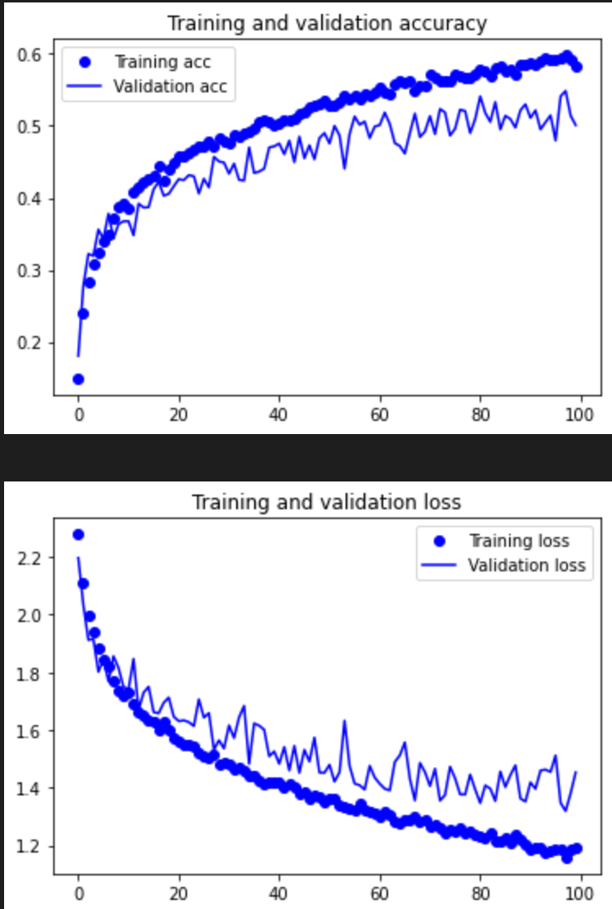
Batch Size 256
Validation acc before overfitting ~ 52%
Overfits at ~ >Epoch 100
But val acc has stagnated

Slide 10
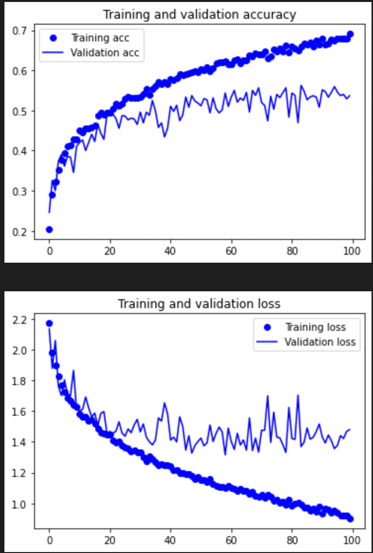
Batch Size 128
Validation acc before overfitting ~ 53%
Overfits at ~ >Epoch 100
But val acc has stagnated

Slide 11
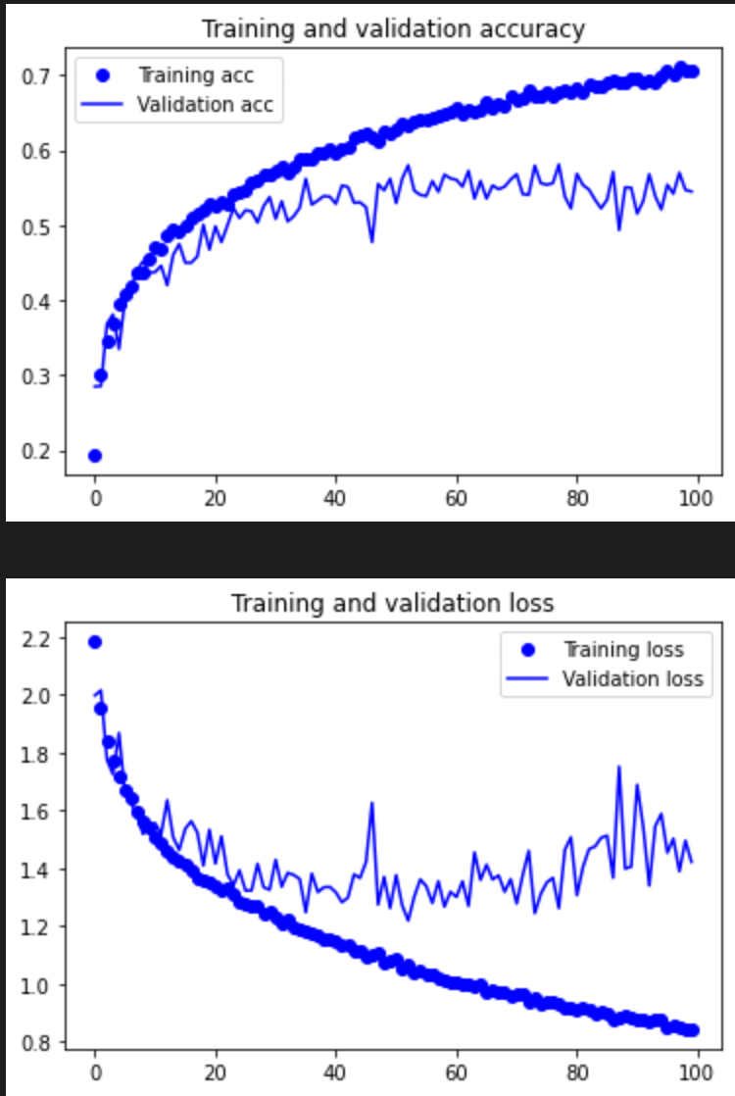
Batch Size 32 (chosen)
Validation acc before overfitting ~ 55%
Overfits at ~ Epoch 70

Slide 12
Selection
Batch size 32
Fastest convergence
Best Accuracy

Slide 13
No. of conv. layers & neurons
Hard to tune these 2 parameters independent of each other
Both are proportionate to model’s complexity
Too complex, model overfits
Too simple, model cannot comprehend data’s complexity
Keep increase complexity until there is no increase in acc
Notes:
Too complex model overfits, low val acc
Too simple … low training acc and val acc

Slide 14
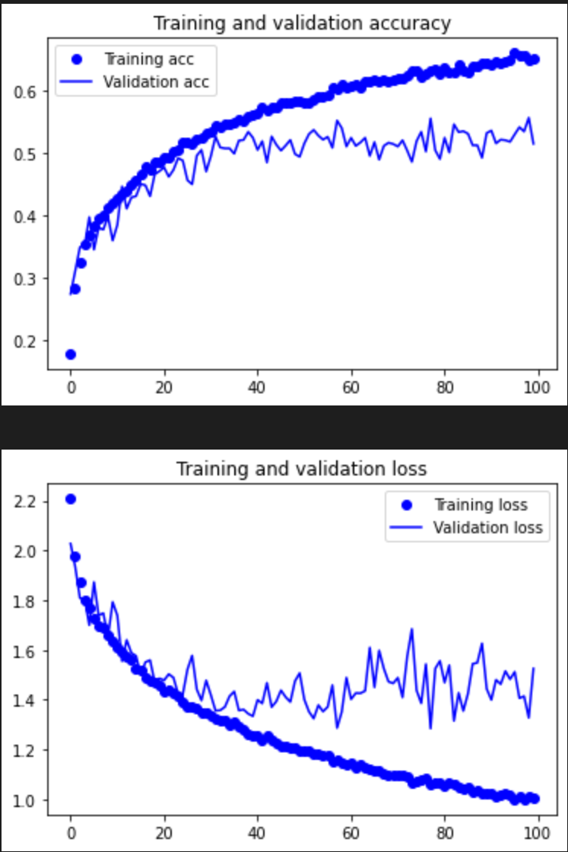
Conv 2L 32N
Validation acc before overfitting ~ 51%
Overfits at ~ Unable to converge OR > Epoch 100

Slide 15
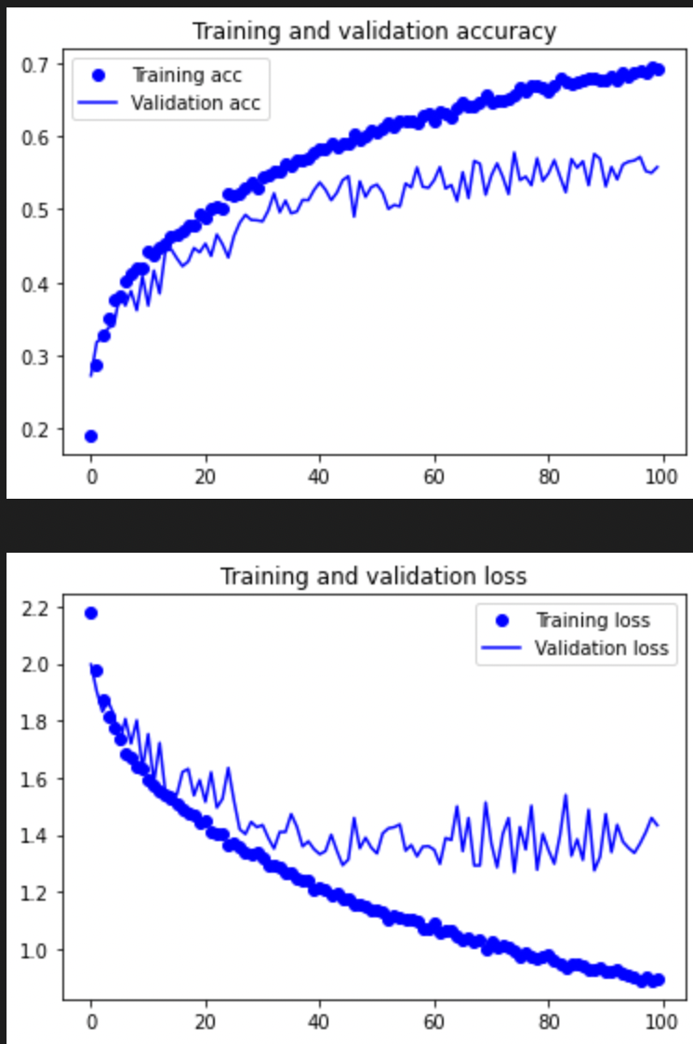
Conv 3L 32N
Validation acc before overfitting ~ 53%
Overfits at ~ > Epoch 100

Slide 16
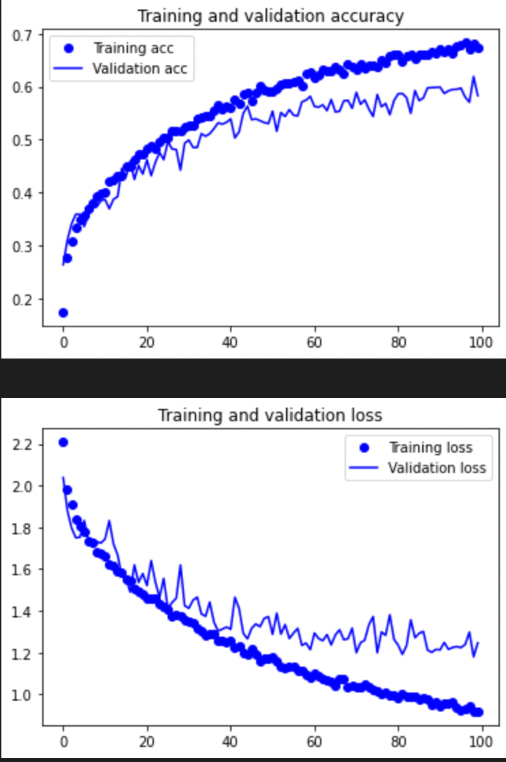
Conv 4L 32N
Validation acc before overfitting ~ 57%
Overfits at ~ > Epoch 100

Slide 17
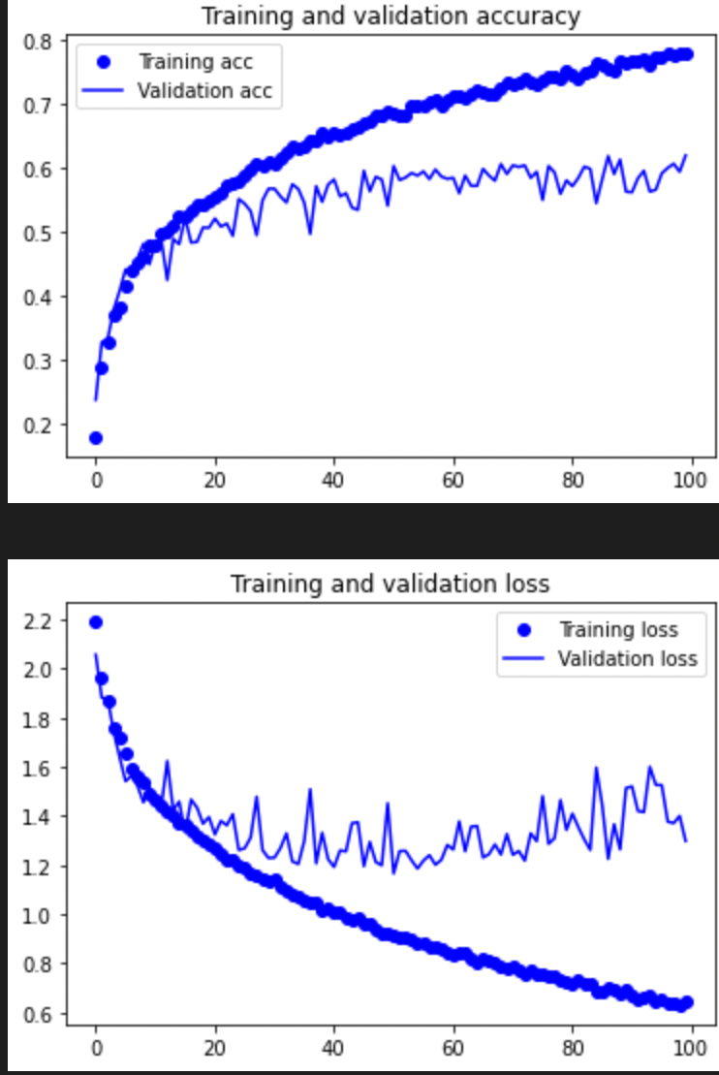
Conv 3L 64N
Validation acc before overfitting ~ 58%
Overfits at ~ Epoch 60

Slide 18
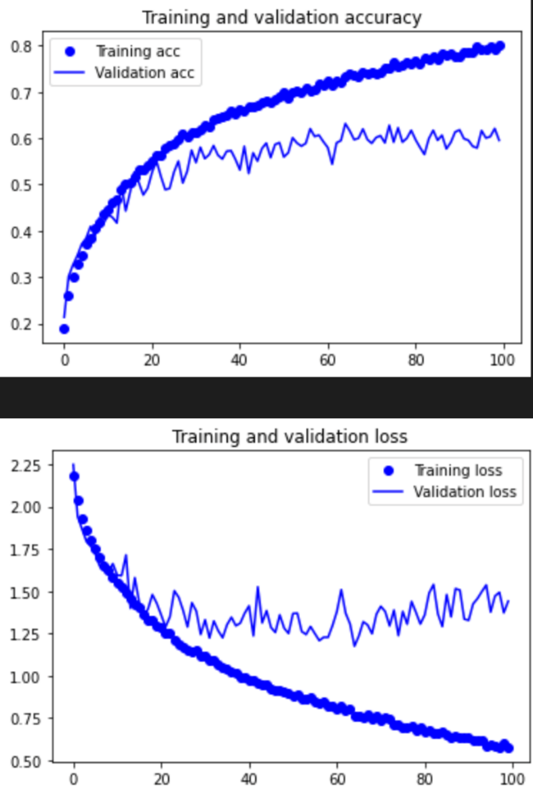
Conv 4L 64N (Conv 64)
Validation acc before overfitting ~ 58%
Overfits at ~ Epoch 60

Slide 19
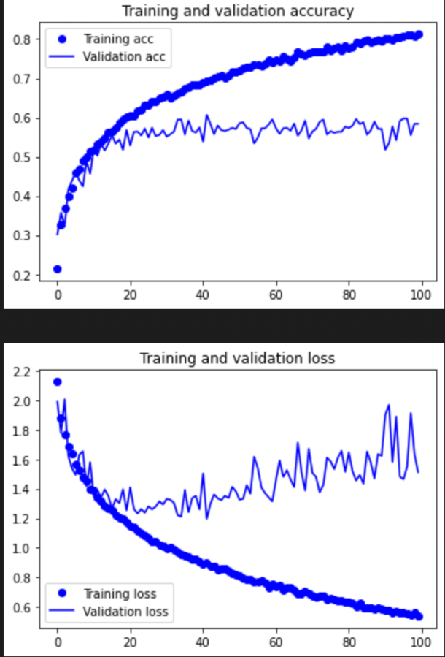
Conv 2L 128N
Validation acc before overfitting ~ 55%
Overfits at ~ Epoch 30

Slide 20
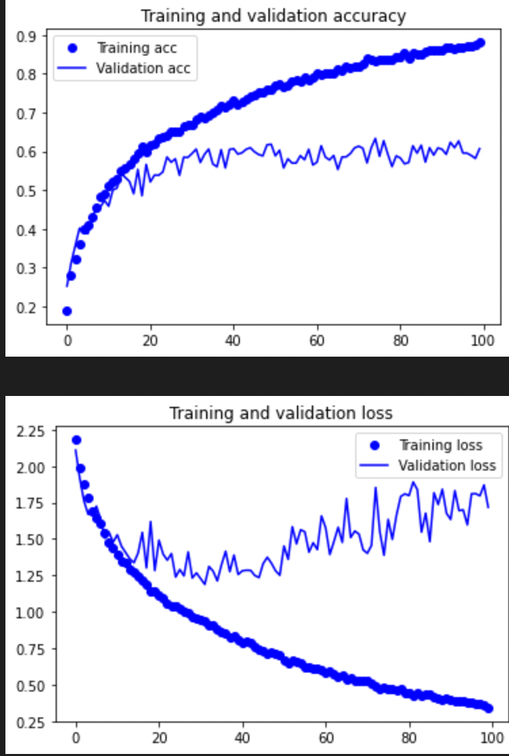
Conv 3L 128N
Validation acc before overfitting ~ 58%
Overfits at ~ Epoch 40

Slide 21
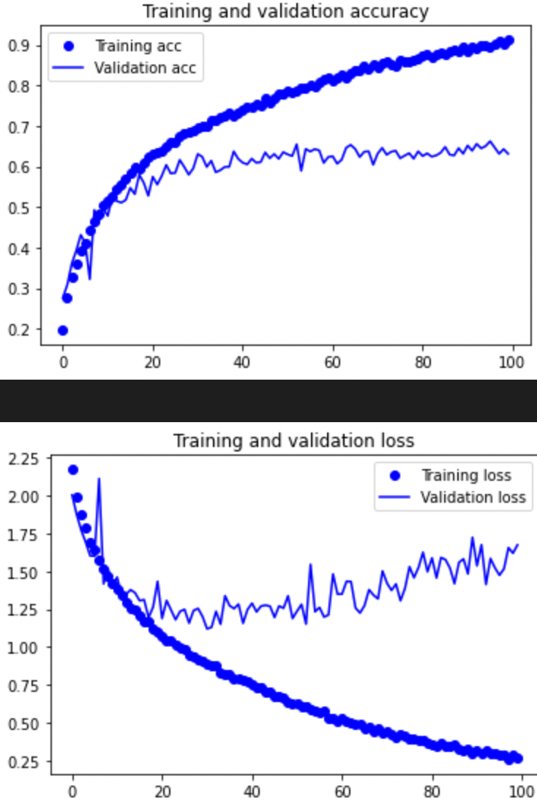
Conv 4L 128N (Conv 128)
Validation acc before overfitting ~ 63%
Overfits at ~ Epoch 50

Slide 22
Selection
- 4L 128N & 4L 64N
Best accuracies
See that models acc increases with complexity

Slide 23
No. of Den layers & neurons
Basically the same as conv layers & neurons
Classifies the images instead of feature extraction
Same approach
Experiment till model gets too complex
Do not count output layer

Slide 24
Conv 64 Den 2L 64N
Validation acc before overfitting ~ 58%
Overfits at ~ Epoch 60

Slide 25
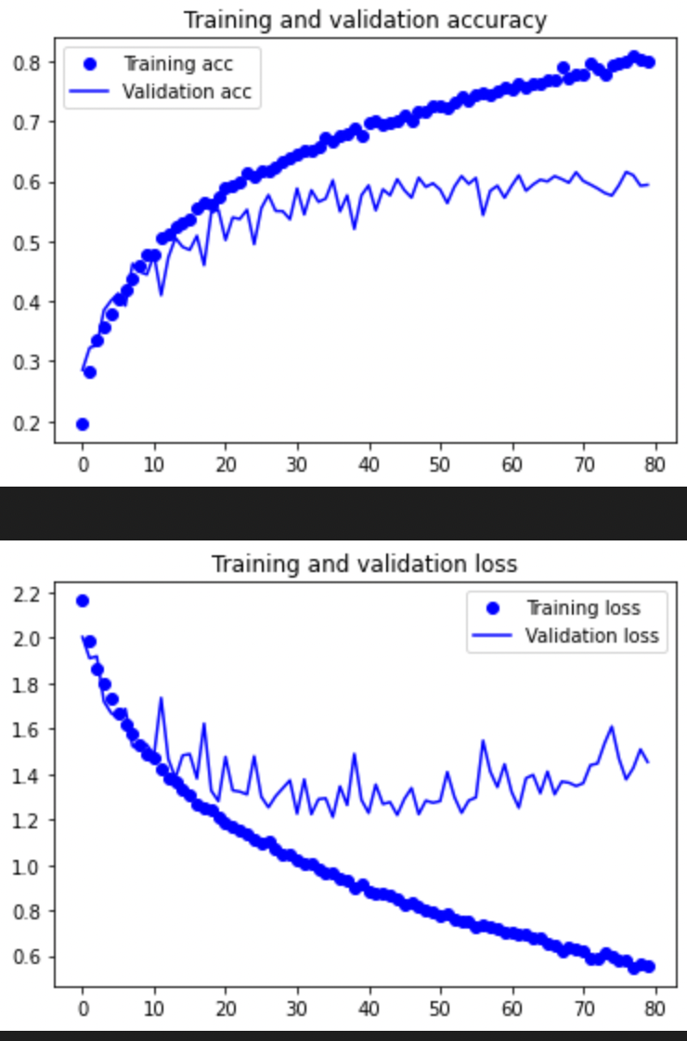
Conv 64 Den 2L 128N
Validation acc before overfitting ~ 56%
Overfits at ~ Epoch 60

Slide 26
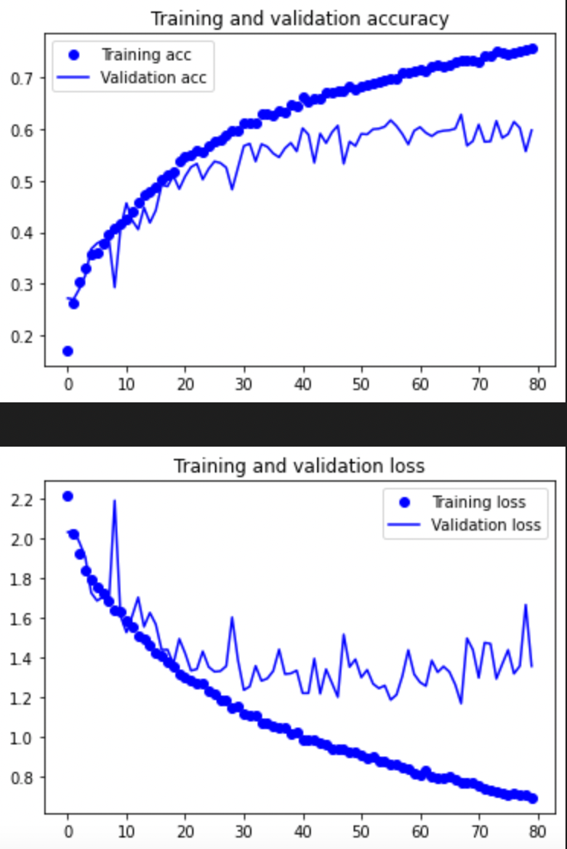
Conv 64 Den 3L 64N
Validation acc before overfitting ~ 57%
Overfits at ~ Epoch 60

Slide 27
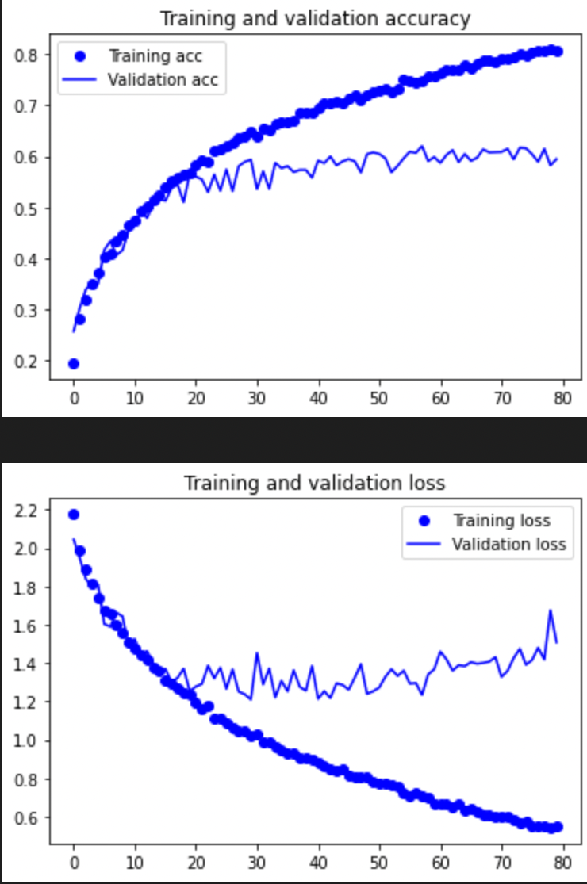
Conv 64 Den 3L 128N
Validation acc before overfitting ~ 59%
Overfits at ~ Epoch 50

Slide 28
Conv 128 Den 2L 64N (SS2)
Validation acc before overfitting ~ 63%
Overfits at ~ Epoch 50

Slide 29
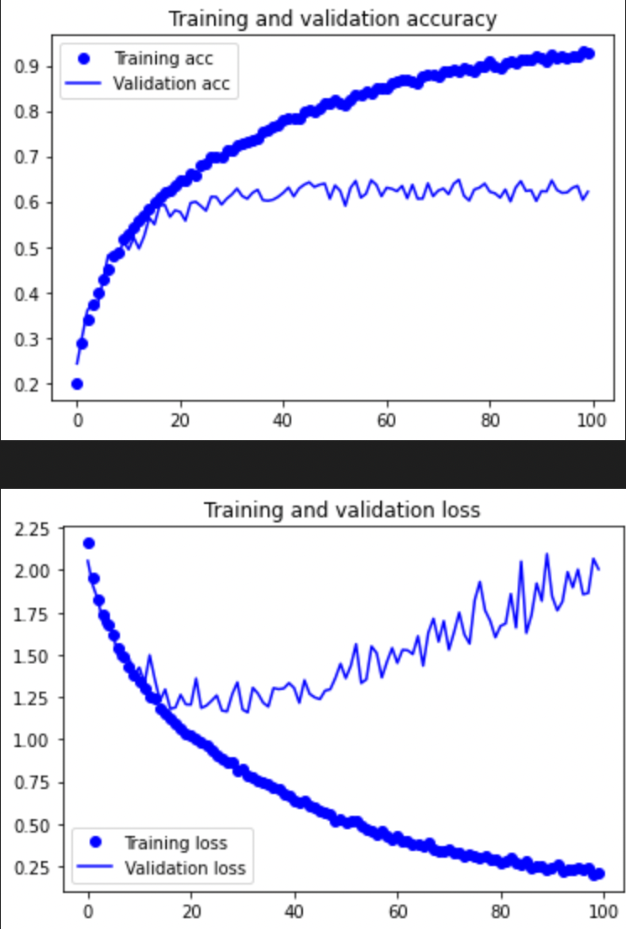
Conv 128 Den 2L 128N
Validation acc before overfitting ~ 62%
Overfits at ~ Epoch 30

Slide 30
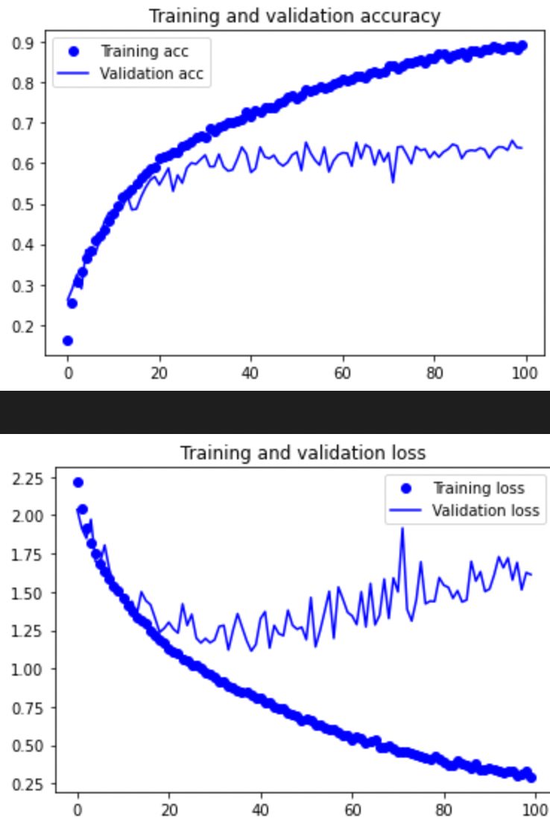
Conv 128 Den 3L 64N
Validation acc before overfitting ~ 60%
Overfits at ~ Epoch 40

Slide 31
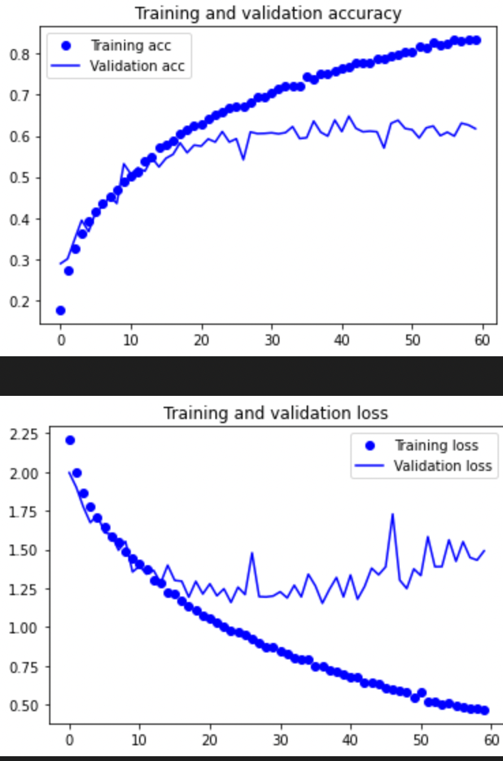
Conv 128 Den 3L 128N (SS3)
Validation acc before overfitting ~ 62%
Overfits at ~ Epoch 40

Slide 32
Optimizers
Responsible for minimizing cost function
Two types adaptive and gradient descent
Gradient descent dependent on lr and often get stuck in local minimums
Adaptive not as affected by lr and works better on sparse data
Took “best” values for the respective optimizers
Adam(adaptive), SGD (gradient descent), RMSprop(adaptive)

Slide 33
SS2 SGD = 0.1
Validation acc before overfitting ~ 60%
Overfits at ~ Epoch 40

Slide 34
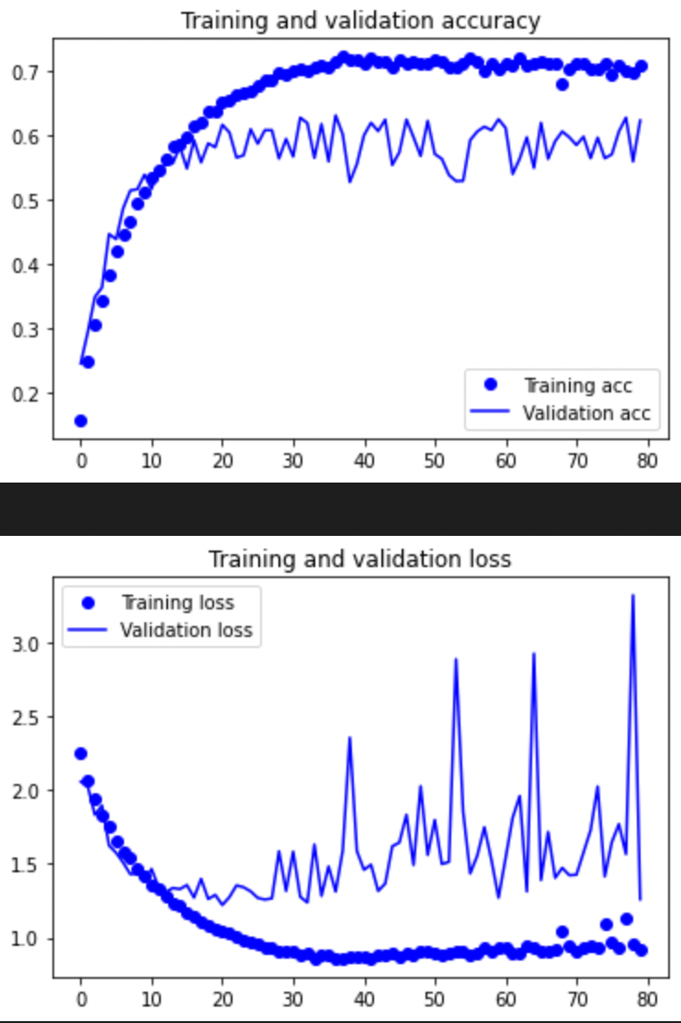
SS2 RMSprop = 0.001
Validation acc before overfitting ~ 58%
Overfits at ~ Epoch 60

Slide 35
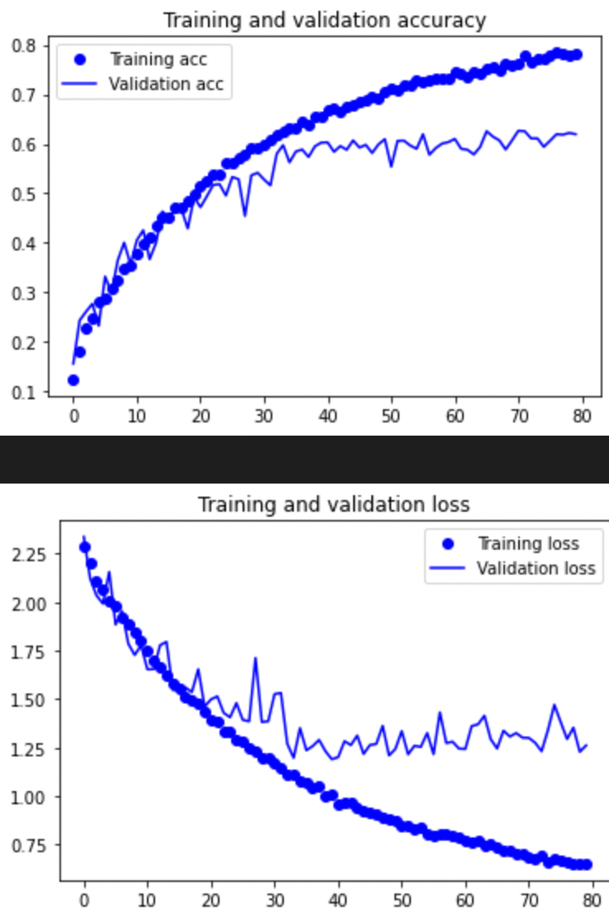
SS3 SGD = 0.1
Validation acc before overfitting ~ 58%
Overfits at ~ Epoch 50

Slide 36
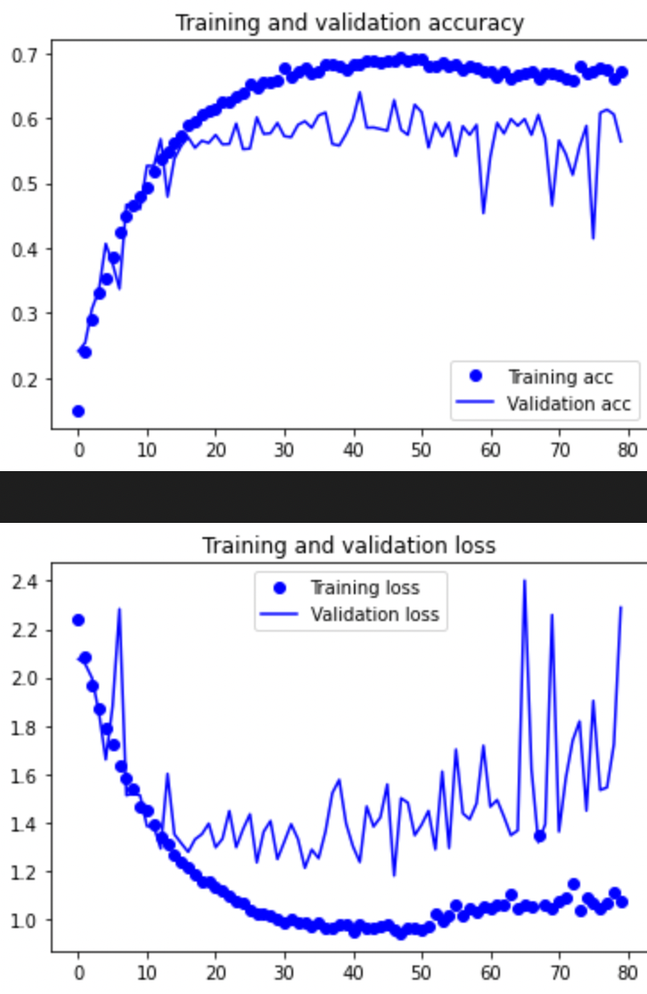
SS3 RMSprop = 0.001
Validation acc before overfitting ~ 59%
Overfits at ~ Epoch 50

Slide 37
Selection
We see that Adam works best for our current models both SS2 and SS3
I will also be dropping SS3 as compared to SS2 it has more noise, lower validation acc and overfits earlier.
This is partly due to time constraints
Hence the model we will be using carrying on is SS2

Slide 38
Learning Rate
After the optimizer, we will fine tune the learning rate
Learning rate is how fast the optimizer will move each time it “learns”
Learning rate cannot be too fast or slow
Notes:
Too fast, converge too quickly at a suboptimal local min (bad acc)
Too slow and it will take to long to learn and might also get stuck in a local minimum

Slide 39
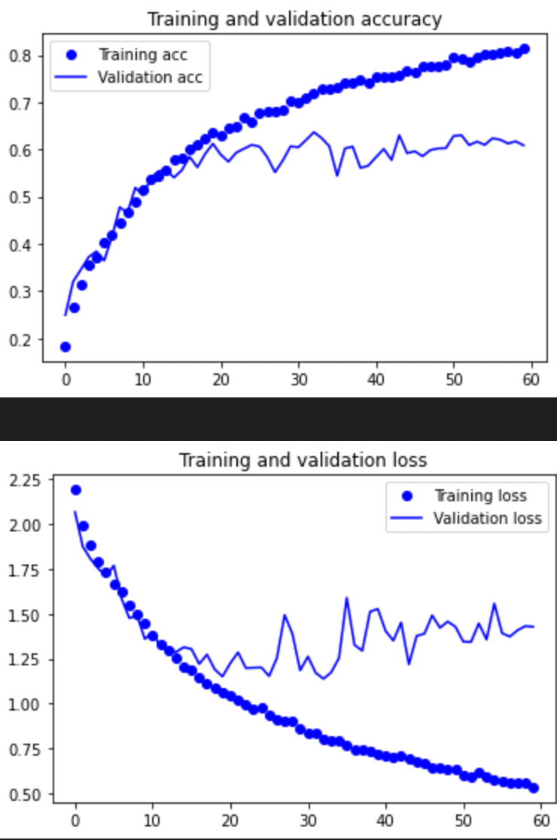
SS2 LR = 0.0008
Validation acc before overfitting ~ 57%
Overfits at ~ Epoch 30

Slide 40
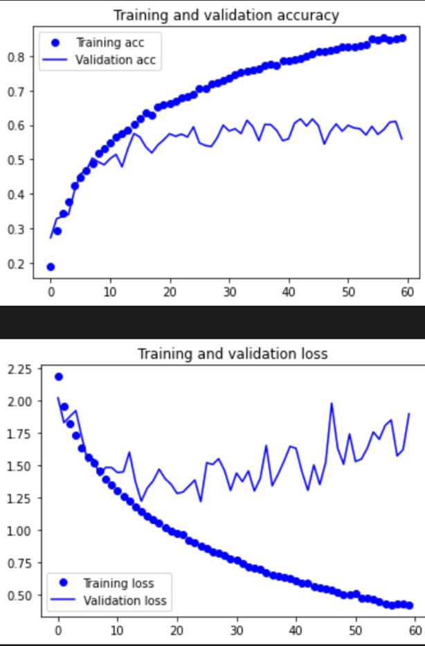
SS2 LR = 0.0006
Validation acc before overfitting ~ 55%
Overfits at ~ Epoch 25

Slide 41
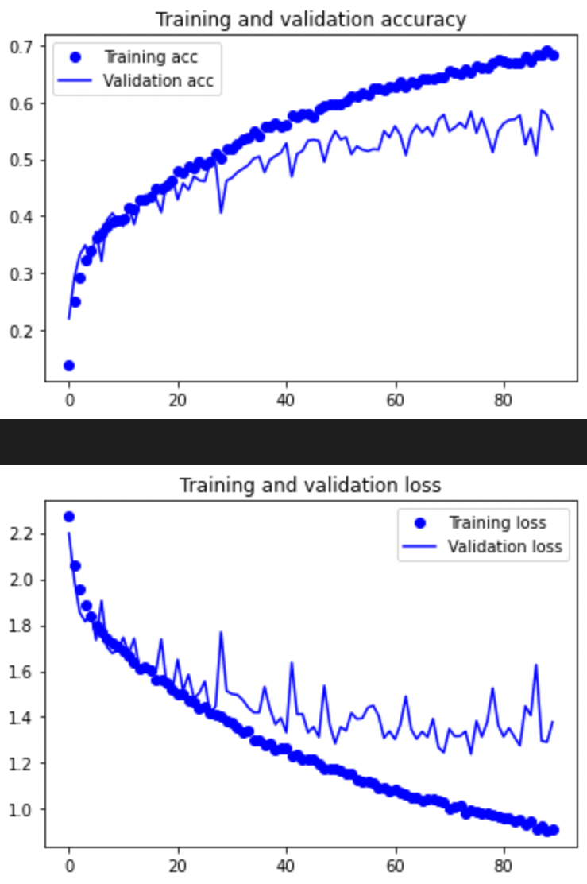
SS2 LR = 0.00008
Validation acc before overfitting ~ 56%
Overfits at ~ > Epoch 80

Slide 42
Weight Initialization
Used to ensure outputs do not explode or vanish during the training
Which would delay model convergence or completely not converge at all
Used Glorot Normal, He Normal and LeCun Normal
Notes:
Outputs explode or vanish because the inputs at the start are either too large or small which causes a snowball effect

Slide 43
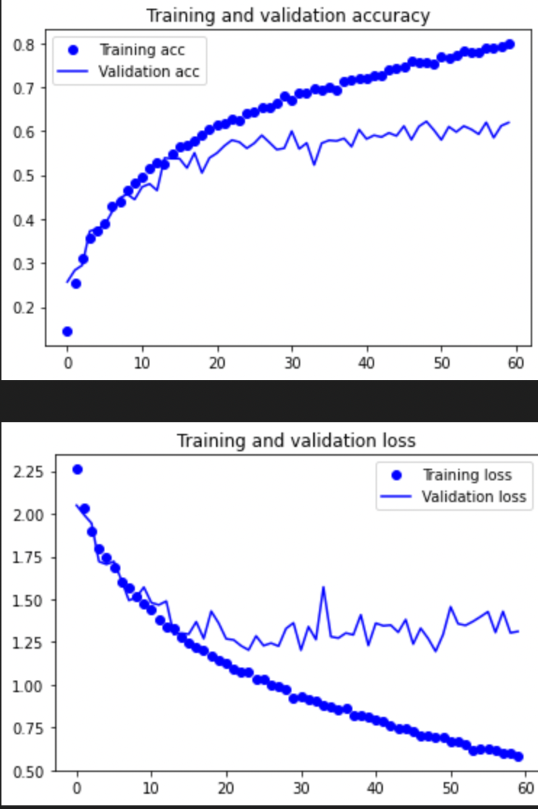
SS2 Glorot Normal
Validation acc before overfitting ~ 57%
Overfits at ~ 45

Slide 44
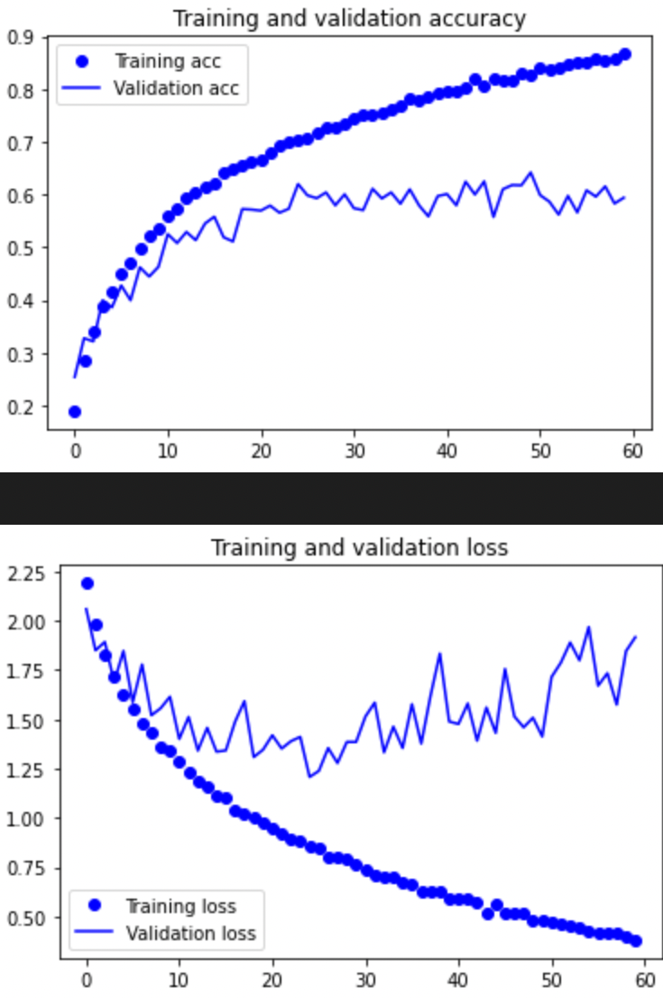
SS2 He Normal
Validation acc before overfitting ~ 58%
Overfits at ~ Epoch 30

Slide 45
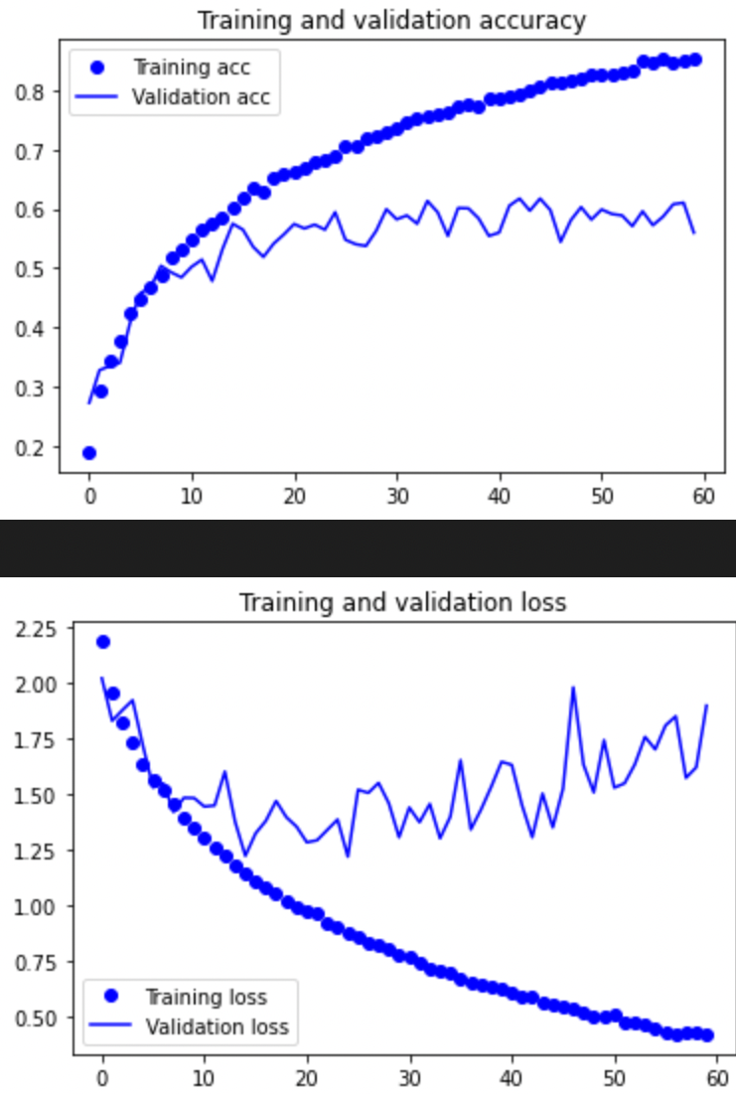
SS2 LeCun Normal
Validation acc before overfitting ~ 57%
Overfits at ~ Epoch 25

Slide 46
Batch Normalization
Layers that will standardize and normalize inputs
Allows model to generalize better
Speeds up training process
Added after every conv layer, between conv and maxpool

Slide 47
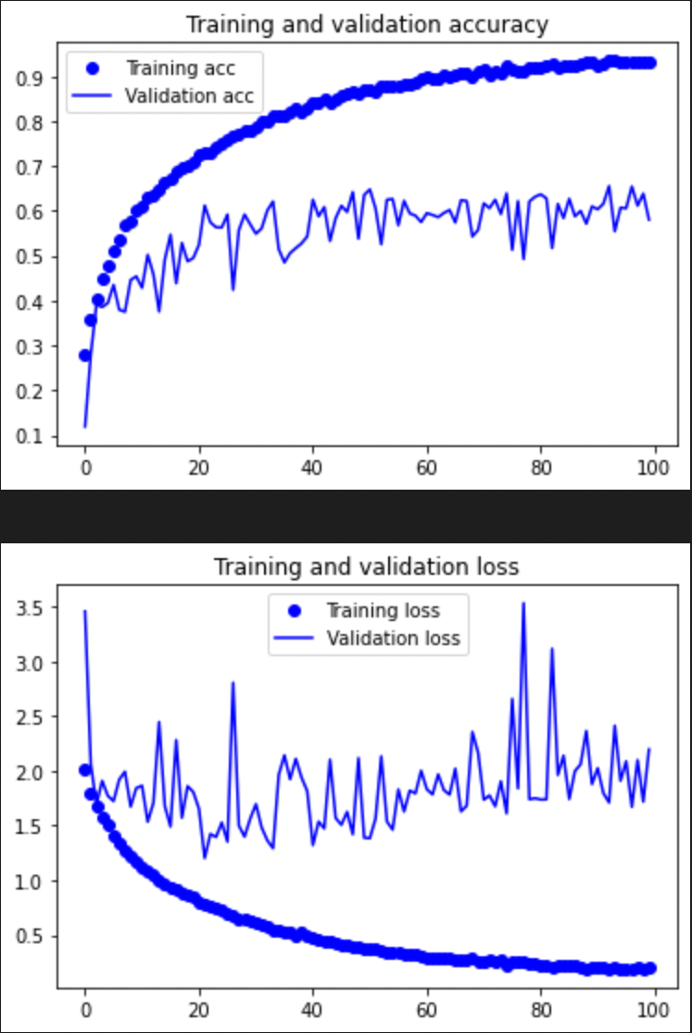
SS2 Batch Normalization
Validation acc before overfitting ~ 60%
Overfits at ~ Epoch 20

Slide 48
Dropout
A layers that randomly turns off neurons during training
To prevent overfitting
Reduce the influence of initial learning batches
Otherwise it would prevent the learning of features that appear later
Dropout rate too low and there is no point of adding it
Too much and model will learn too slowly and could get stuck in a local minimum

Slide 49
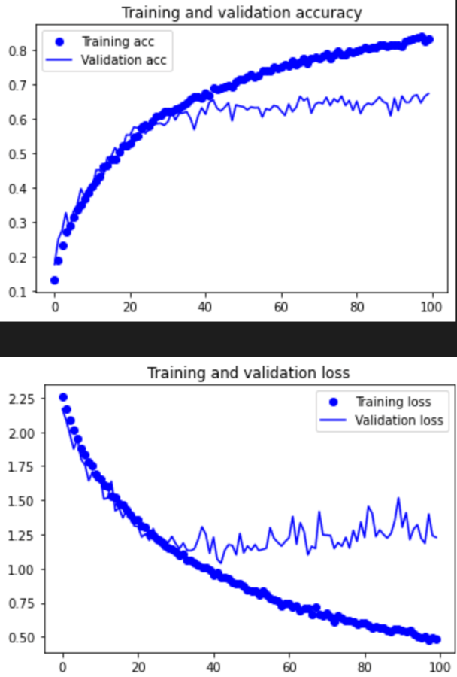
SS2 Dropout = 0.3
Validation acc before overfitting ~ 63%
Overfits at ~ Epoch 50

Slide 50
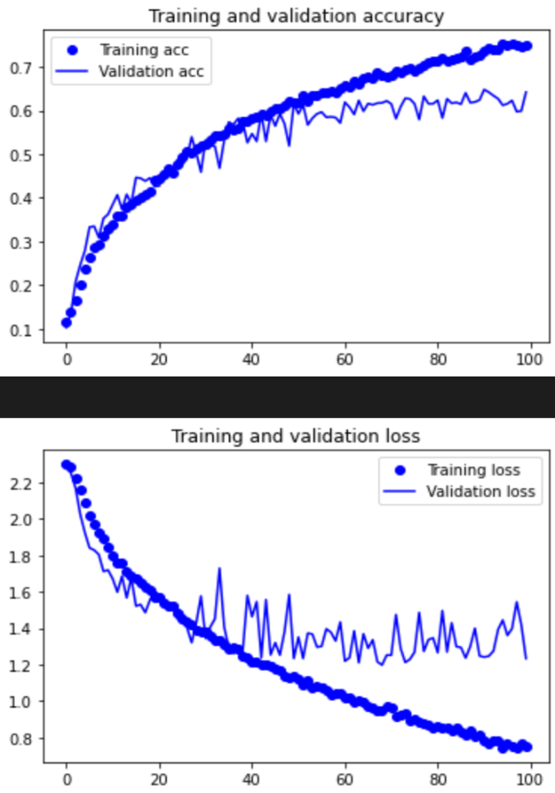
SS2 Dropout = 0.5
Validation acc before overfitting ~ 62%
Overfits at ~ Epoch 70

Slide 51
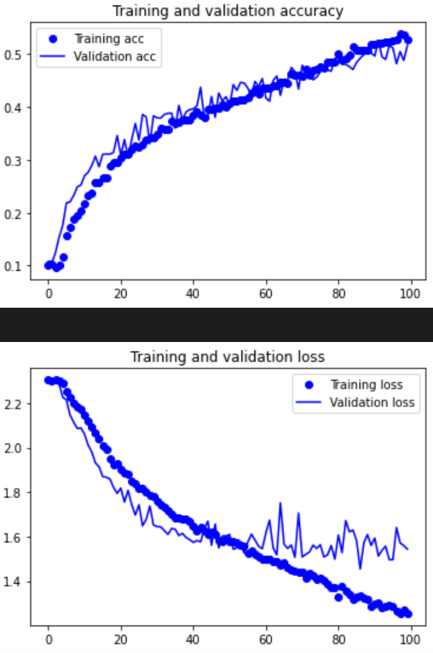
SS2 Dropout = 0.7
Validation acc before overfitting ~ Too long to train
Overfits ~ Epoch > 100

Slide 52
Regularizers
Regularizers penalize the output of activation functions
Used to prevent overfitting
Significantly reduces variance of model w/o increase in its bias
Higher the penalty, slower model takes to converge. Vice versa

Slide 53
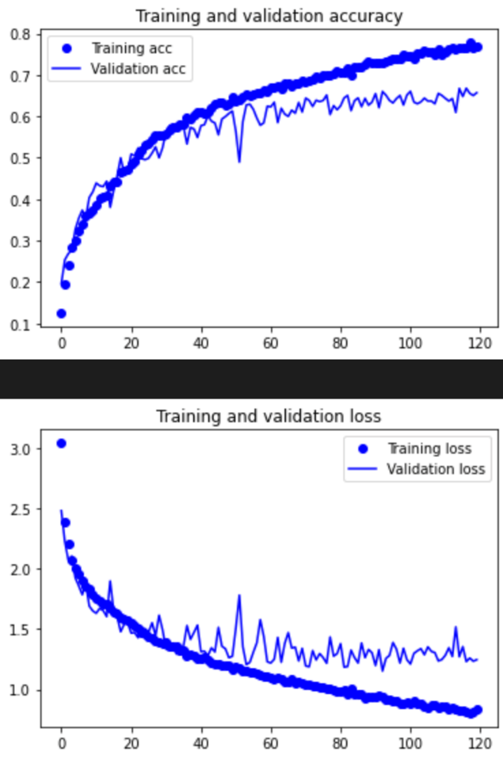
SS2 L2 = 0.01
Validation acc before overfitting ~ 65%
Overfits at ~ Epoch > 120

Slide 54
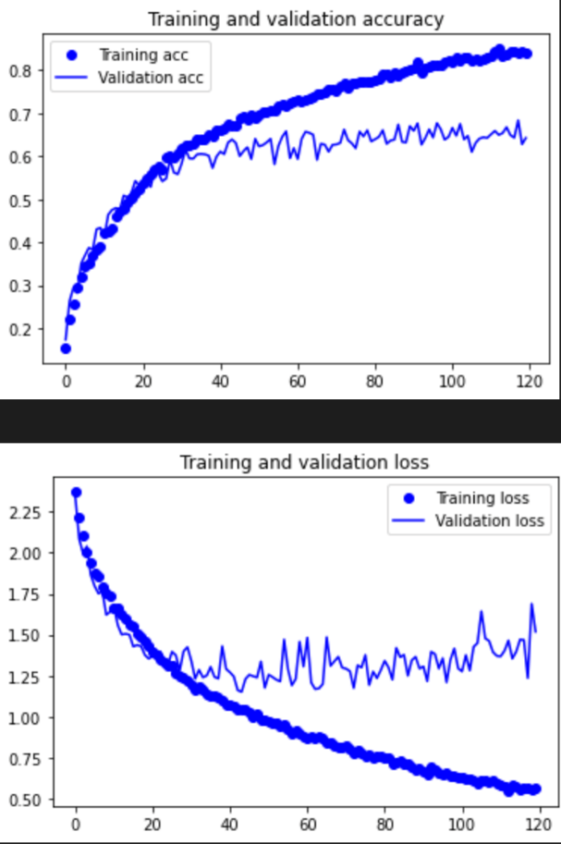
SS2 L2 = 0.001
Validation acc before overfitting ~ 63%
Overfits at ~ Epoch 80

Slide 55
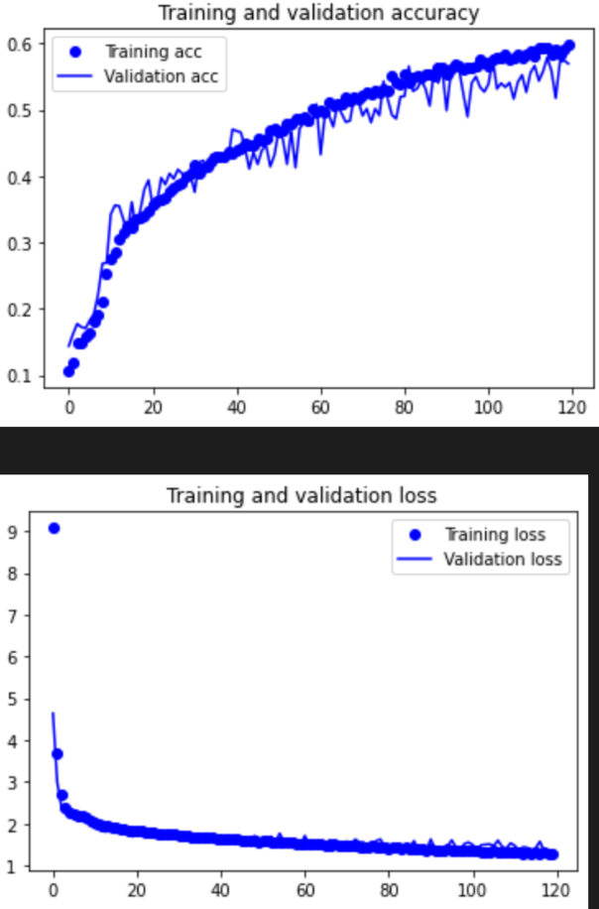
SS2 L2 = 0.1
Validation acc before overfitting ~ 55%
Overfits at ~ > Epoch 120

Slide 56
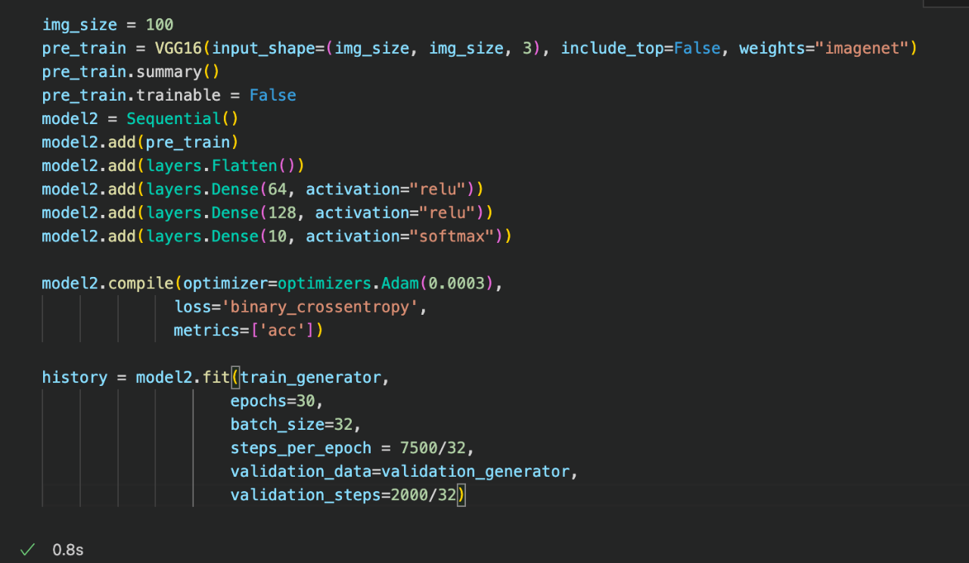
Pre-Train

Slide 57
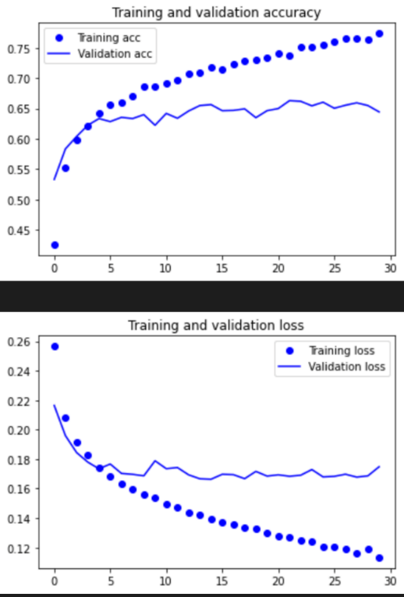
Base Model
Validation acc before overfitting ~ 64%
Overfits at ~ > 30
Loss stagnates at epoch 15

Slide 58
Fine tuning
Unfroze top most layer B5C1
So that I can tune it for model to generalize better
Prevented overfitting using dropout and regularization
Tried different architectures

Slide 59
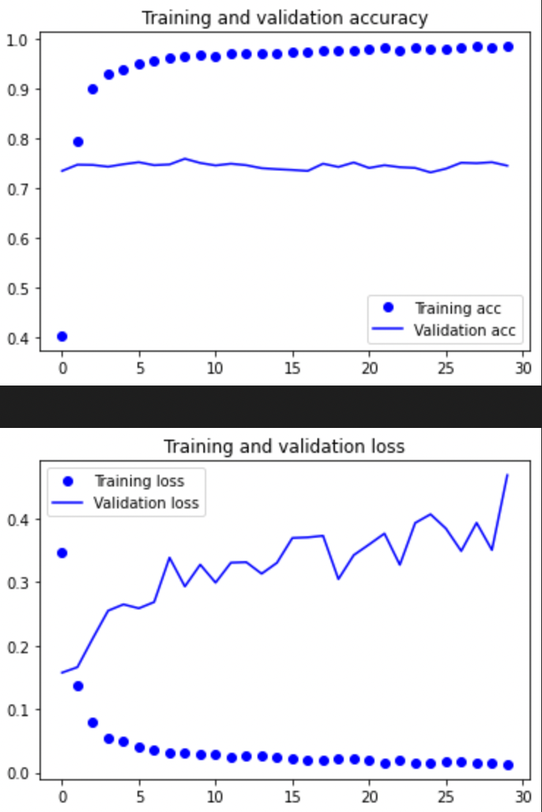
2 Dense Layers
Validation acc before overfitting ~ 73%
Overfits at ~ Epoch 1

Slide 60
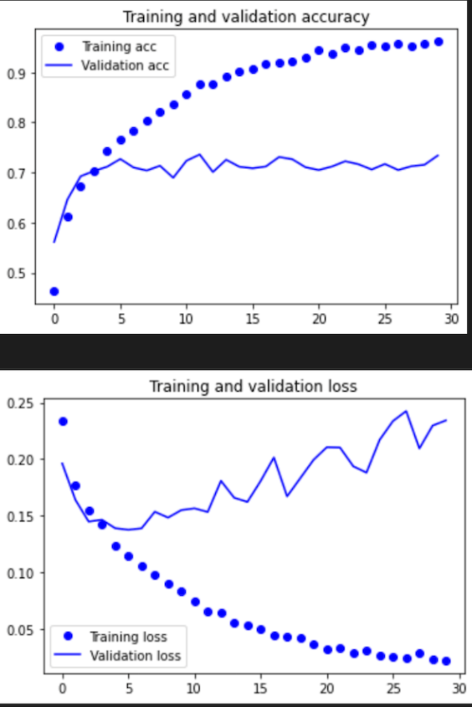
2 DL+ Dropout
Validation acc before overfitting ~ 71%
Overfits at ~ Epoch 7

Slide 61
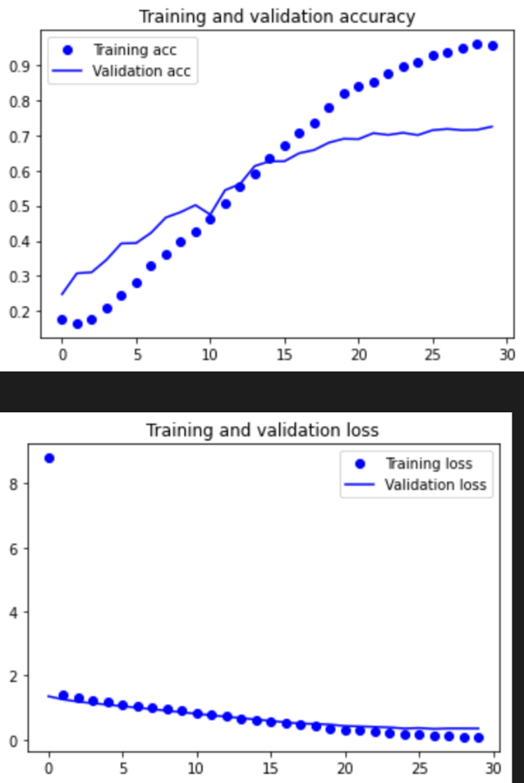
2 DL+ DO + Regularizers
Validation acc before overfitting ~ 70%
Overfits at ~ > Epoch 30
Rate of increase in Acc slows down around epoch 25

Slide 62
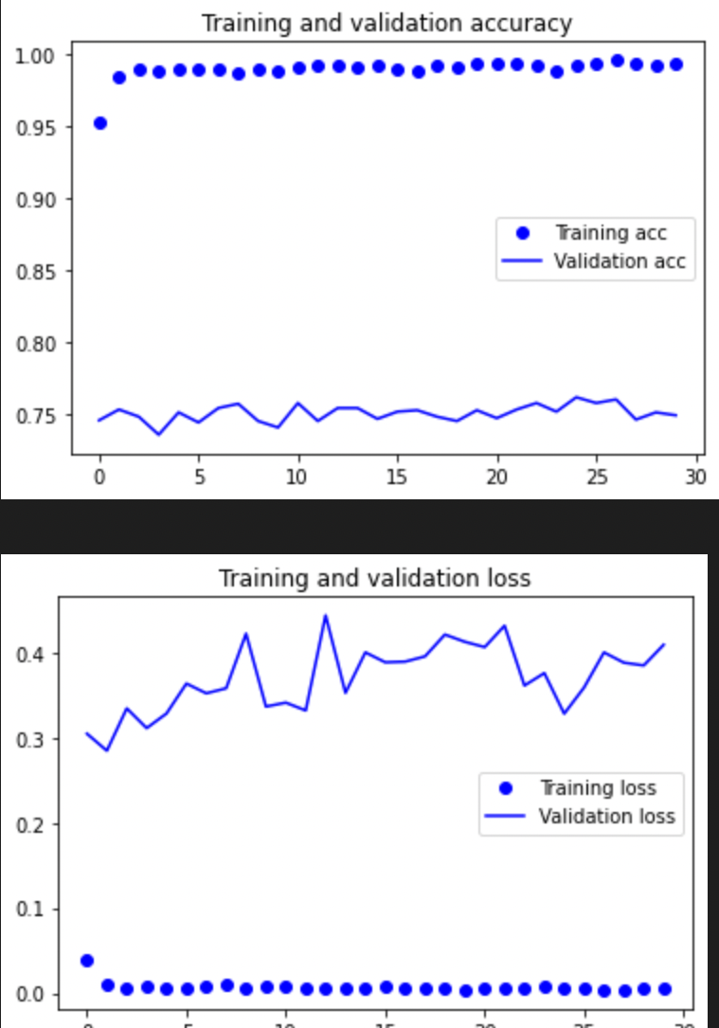
3 Dense Layers
Validation acc before overfitting ~ 75%
Overfits at ~ Epoch 1

Slide 63
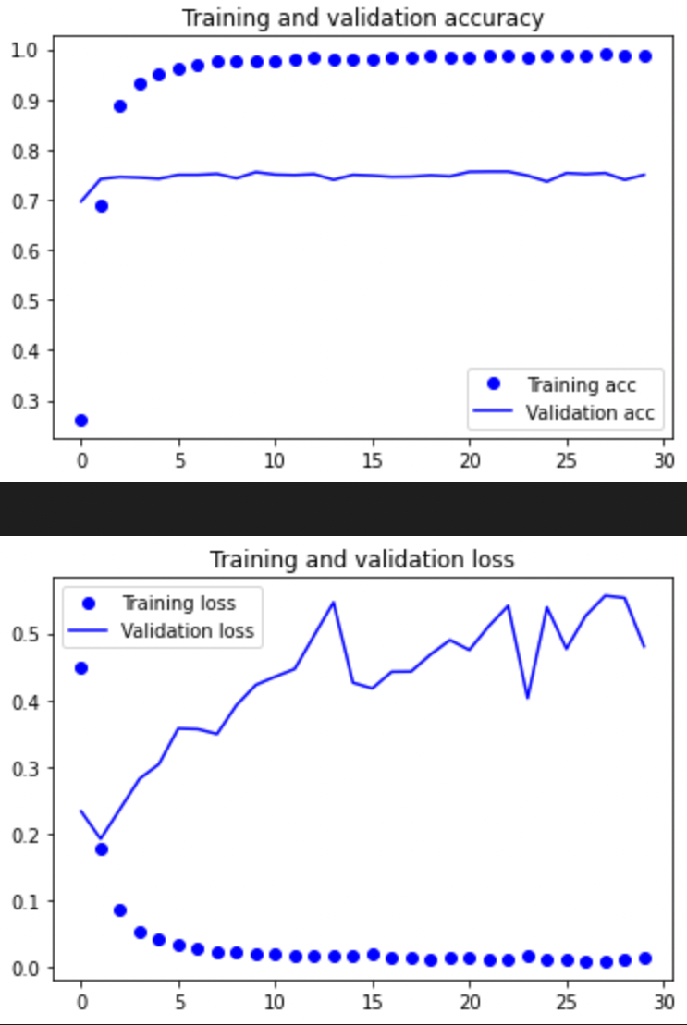
3 DL + Dropout
Validation acc before overfitting ~ 75%
Overfits at ~ Epoch 2

Slide 64

3 DL + DO + Regularizers
Validation acc before overfitting ~ 71%
Overfits at ~ > Epoch 15
Acc rate of increase slows around epoch 10. But it will still increase.

Slide 65
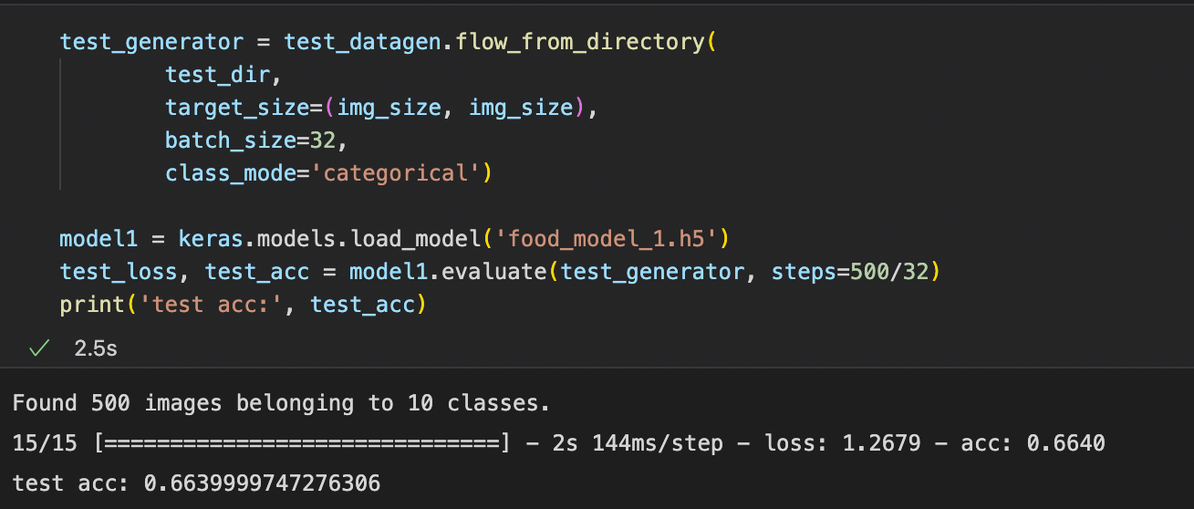
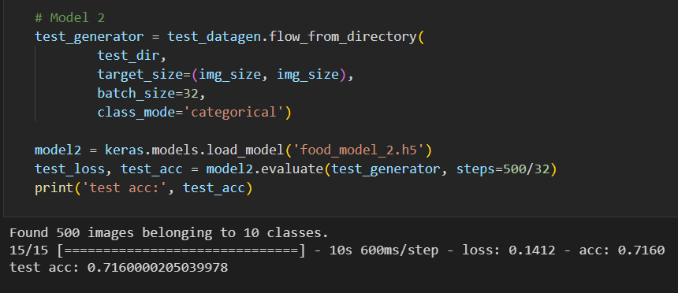
Evaluation

Slide 66
Evaluation
Overall the pre-train did better than the model from scratch
It has a better validation accuracy
However a slower training time
Overall better

Slide 67
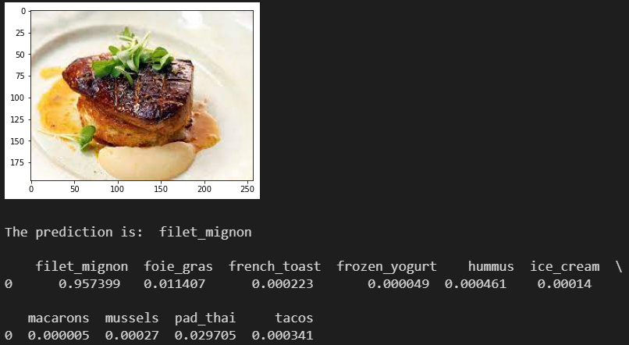
Best model to perform classification
Model was wrong
95% sure is was filet mignon
Foie gras has similar colour and height
Also had a charred top
Model got confused

Slide 68
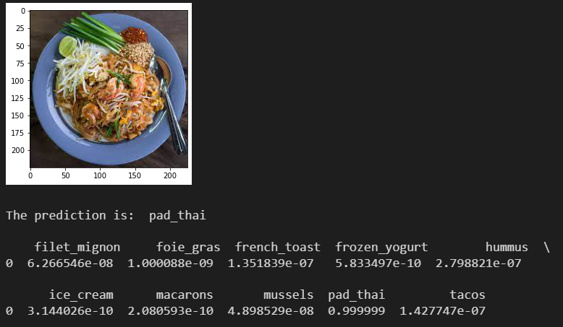
Best model to perform classification
Predicted correctly
Very sure in its guess
Overall model was 4/5

Slide 69
Summary
For both models, biggest issue was time constraints.
For some models, did not train till true overfitting
For some, could not do extensive testing and tuning of hyperparameters
E.g. Pre-Train did not tune drop out values
E.g. Built from scratch did not try a wide range of values
Interpretation of the graph might be wrong
Suboptimal models chosen

